Slide 1
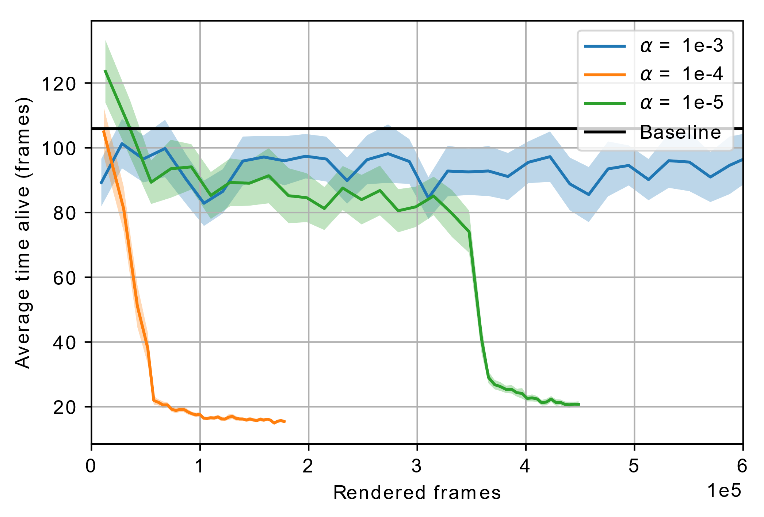
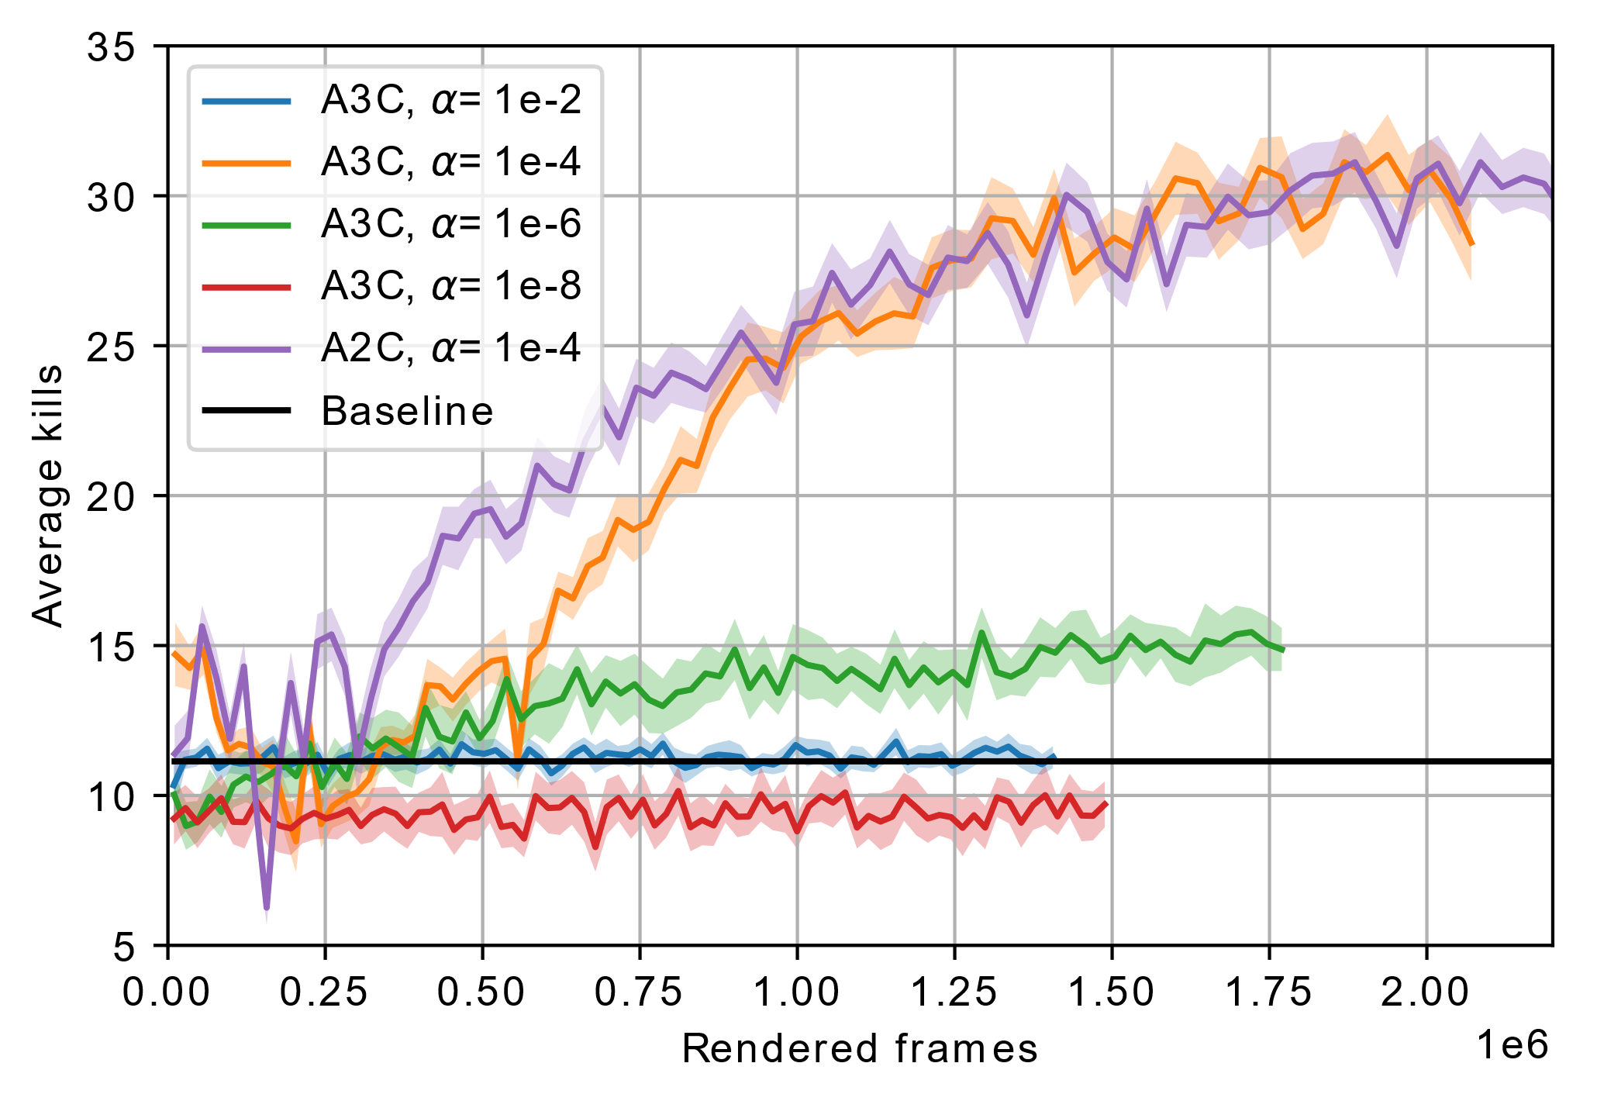
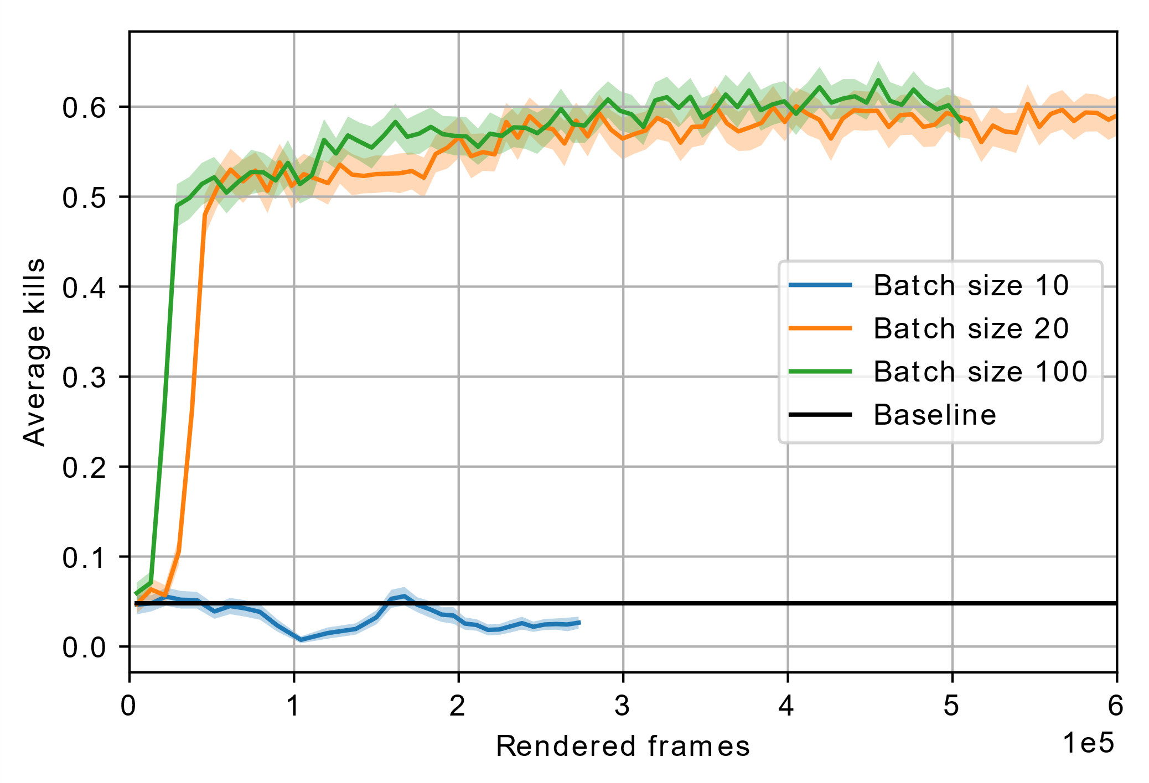
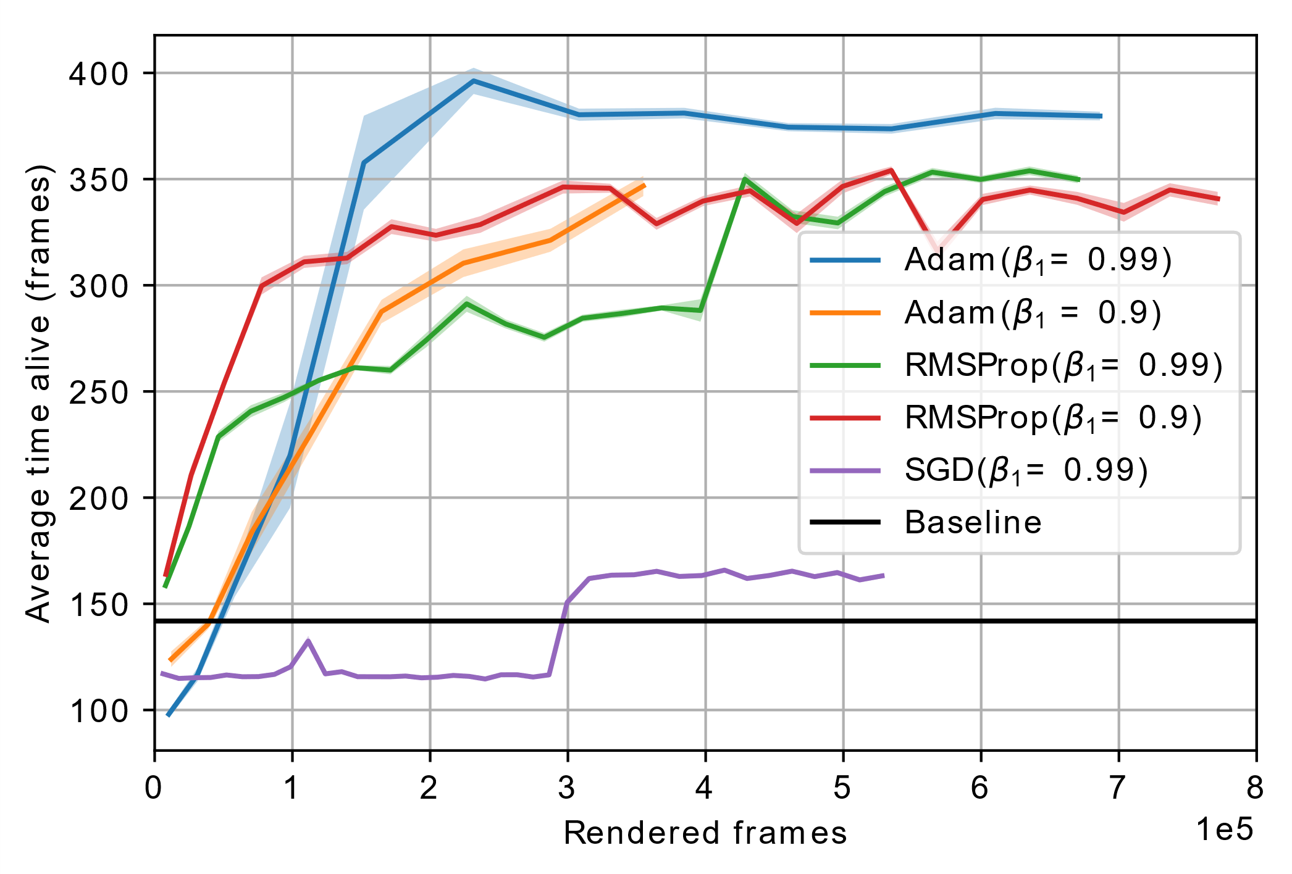
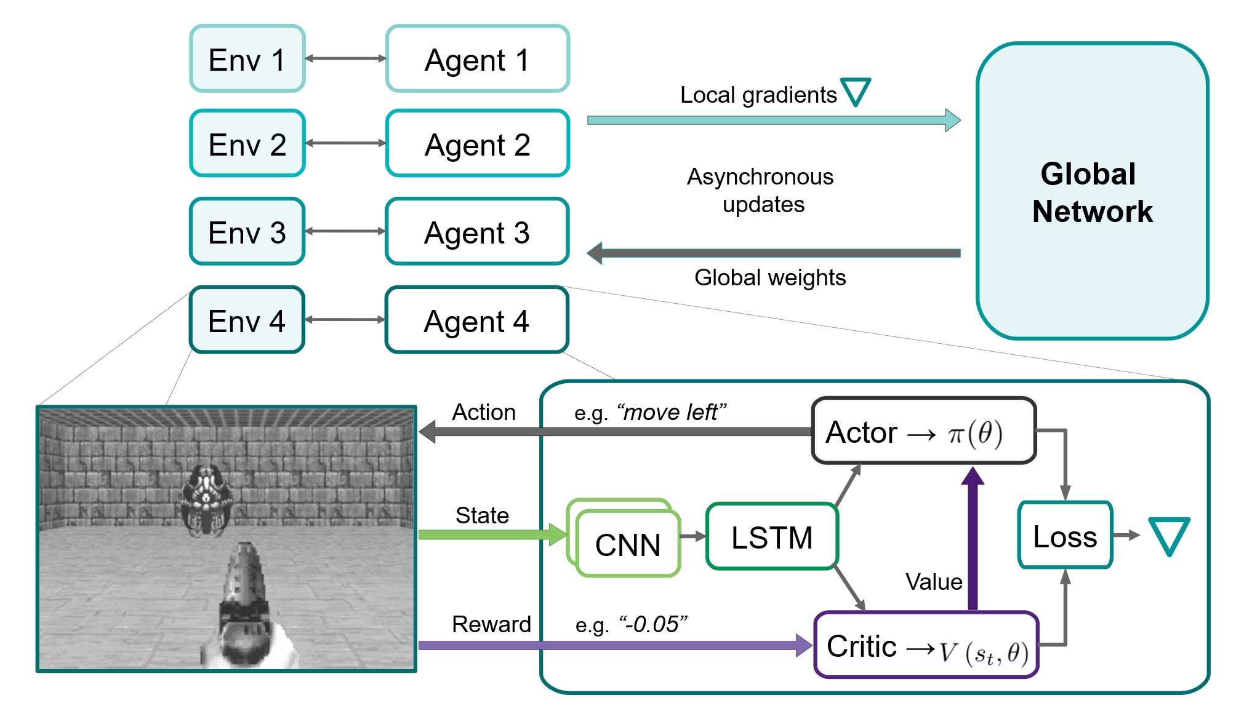

Asynchronous advantage actor-critic methods on ViZDoom
Aksel Obdrup (s144089), Elin Dijkstra (s182774), Louis Hein (s181573) & Tobias Konradsen (s144077) – DTU Compute – 02460 Advanced Machine Learning
Reinforcement learning algorithms learn behavior in various enviroments based on rewards for actions.
ViZDoom: Partially observable environment with sparse or delayed rewards
Other implementations based on experience replay
Computationally heavy and unstable
→ Asynchronous approach proposed
Basic
Defend the line
Predict Position
Defend the center
Learning is sensitive to hyperparameters
Learning rate: Optimal found ${10}^{−4}$
Batchsize: Scenario dependent, larger than 10
Optimizers: Adam outperformes RMSProp and SGD
Non trivial behavior on all presented scenarios

